Slide 1


IMPORTANCE OF
APTITUDE
MS.ROLI SHRIVASTAVA
Corporate Trainer
APTITUDE_ENHANCER
ROLI SHHRIVASTAVA

Slide 2

APTITUDE
Several elements play a vital role in achieving success, but it all starts where
Attitude Meets Aptitude
If you have the right attitude but lack the required aptitude, success can be difficult.

Slide 3
APTITUDE
Attitude defines how you work or proceed towards your goal.
Aptitude, on the other hand, defines how much potential you have to learn specific skills or gain knowledge that will help you achieve your goal.
APTITUDE is a component of a competence to do a certain kind of work at a certain level.
It is learned or acquired ability of an individual to perform a certain tasks.

Slide 4


Slide 5

ROLE OF APTITUDE
In a constantly changing work environment, aptitude is crucial if you want to taste success.
If you have the potential to learn new skills and develop them over a time, success will not be far.
You can learn several new skills on the job; in the same way, you can learn a lot outside your job as well.
One of the most important aspects is that you first need to identify your interest and core strength area.

Slide 6

ROLE OF APTITUDE
The most important thing to remember is "knowledge is still the king" and if you have an insatiable thirst for the knowledge, you have the right aptitude for success!
The statistics reveal that 70 percent of world’s recruitment companies use aptitude test as a part of their recruitment procedure.
These types of tests often permit potential companies to learn more about candidate’s personality and abilities.

Slide 7

APTITUDE TEST IN JOB RECRUITMENTS
The inception of most recruitment process starts with the test of aptitude ability which is most often referred to as ‘aptitude round’/ prelim.
Being conducted at the first and foremost stage of the recruitment process, it has its own unique importance.
It is applied as a means to separate the potential skilled candidates from the crowd that has gathered for the recruitment process.

Slide 8


Slide 9
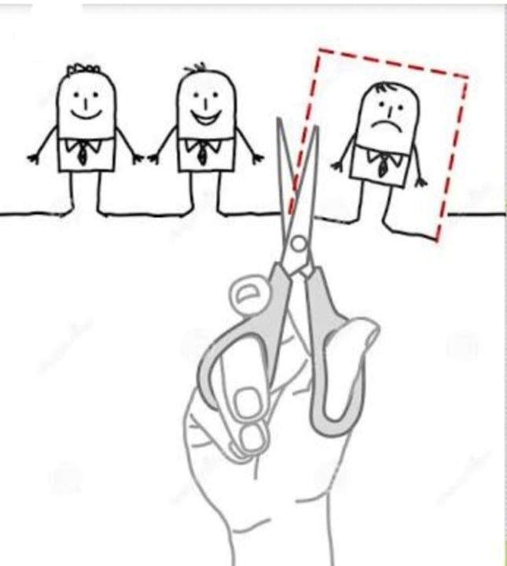
APTITUDE TEST IN JOB RECRUITMENTS
Aptitude test is generally conducted as an
ELIMINATION ROUND
(i.e. if you fail-good bye to you)
Major refinement of candidates is done at this stage.

Slide 10

CONTENTS OF APTITUDE TEST
Test of aptitude consists of following sections:-
Quantitative Aptitude (hereinafter referred to as Quant and better known as Mathematics)
Data Interpretation
Logical Reasoning

Slide 11
MAJOR TOPICS OF QUANTITATIVE APTITUDE SECTION
Basics Of Number System
Sequences & Series
Percentages
Profit And Loss
Simple Interest & Compound Interest
Averages
Ratio, Proportions & Variations
Time, Speed & Distance
Mixtures & Allegations

Slide 12
MAJOR TOPICS OF QUANTITATIVE APTITUDE SECTION
Work & Time
Permutation & Combination (Basic Level)
Probability (Basic Level)
Series Based
Geometry (Occasionally Asked)
Permutation & Combination (Higher Level)
Probability (Higher Level)
Mensuration
Data Interpretation

Slide 13
MAJOR TOPICS OF LOGICAL REASONING SECTION
Direction Sense Test
Seating Arrangement
Syllogism
Visual Reasoning
Coding - Decoding
Blood Relation Based Problems
Series Based Questions
Verbal Reasoning
Puzzles

Slide 14

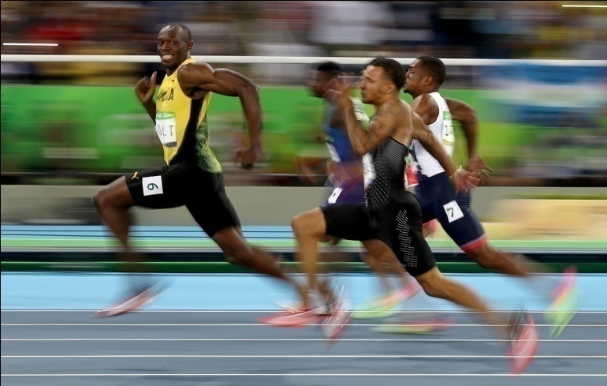
APTITUDE TEST
Aptitude test is like a RACE AGAINST TIME meaning that the time allotted and the number of questions is almost always inversely proportional to each other with time always being on the lower side.
Most often you will have less than a minute per question in an aptitude test.

Slide 15
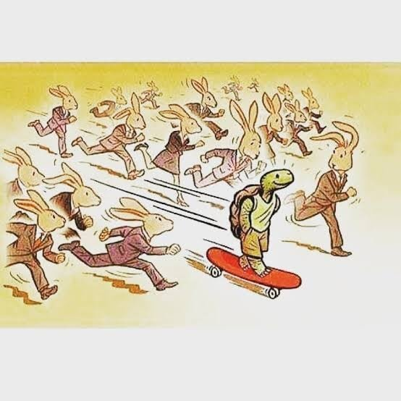
APTITUDE TEST
In order to be successful in aptitude round you need to be QUICK & SMART
It is only possible with a fair amount of practice and in order to practice well you must aware of the contents of each section.

Slide 16
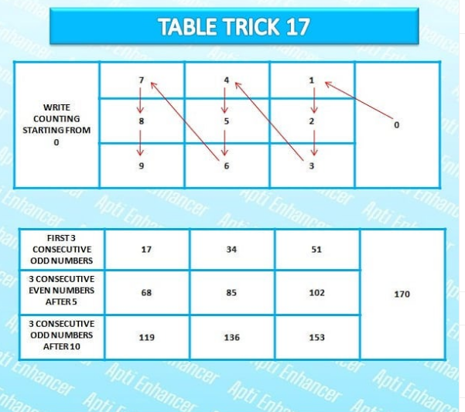

Slide 17
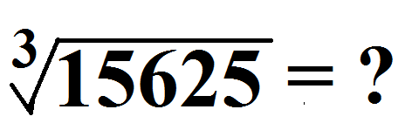

TEST YOUR KNOWLEDGE

Slide 18
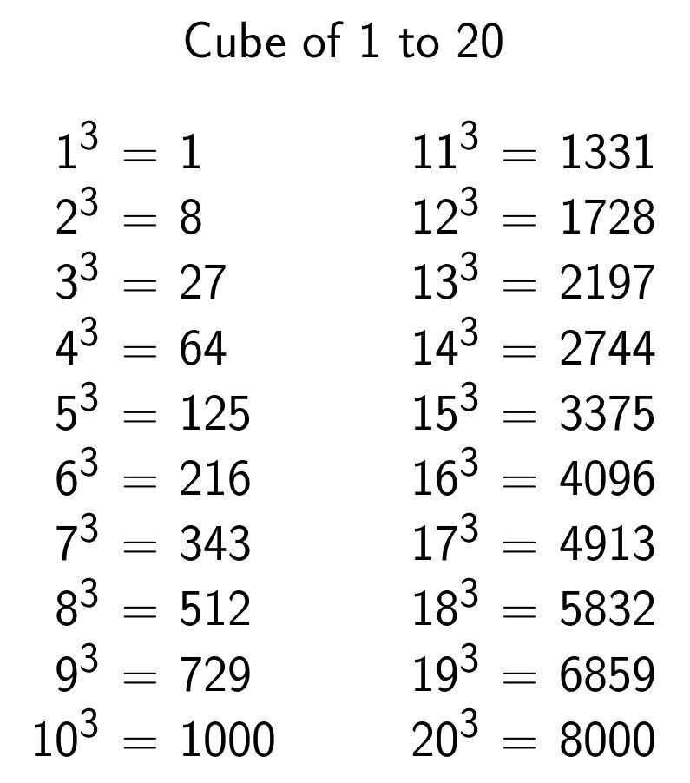
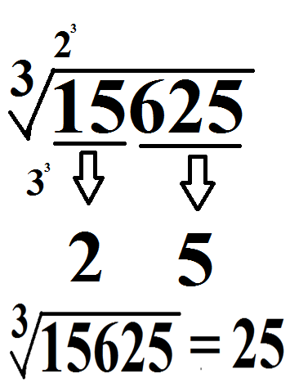
TEST YOUR KNOWLEDGE
UNIT DIGIT OF THE QUESTION IS SAME AS THE UNIT DIGIT OF THE ANSWER.
EXCEPT
2<----->8
3<----->7

Slide 19
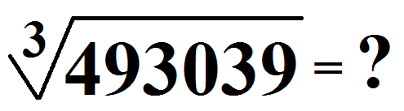
TEST YOUR KNOWLEDGE
UNIT DIGIT OF THE QUESTION IS SAME AS THE UNIT DIGIT OF THE ANSWER.
EXCEPT
2<----->8
3<----->7

Slide 20

(102)² = ?

Slide 21

TEST YOUR KNOWLEDGE
(102)² = 10404
102+2, 2²
104, 04
10404
(109)² = ?

Slide 22
PERCENTAGE
What is 49% of 650?
50%-1%=49%
325-6.5=318.5
What is 52%of 820?
50%+2%=52%
410+16.4=426.4

Slide 23
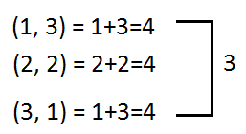
PROBABILITY
What is the probability of getting a sum of 4 if two dices are rolled together?
We can see that the sum of 4 can be obtained by:
Solution: Total out comes = 6*6=36 (because two dices are thrown so the total outcome will be 36) The required probability = Favorable outcomes /Total outcomes = 3/36=1/12

Slide 24
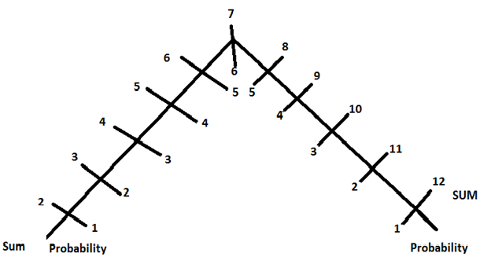
PROBABILITY

Slide 25
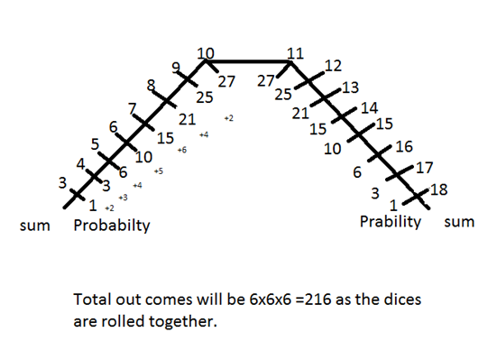
PROBABILITY

Slide 26
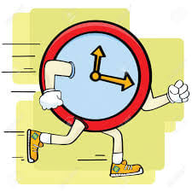

SPEED AND ACCURACY

Slide 27


Slide 28




